Slide 1
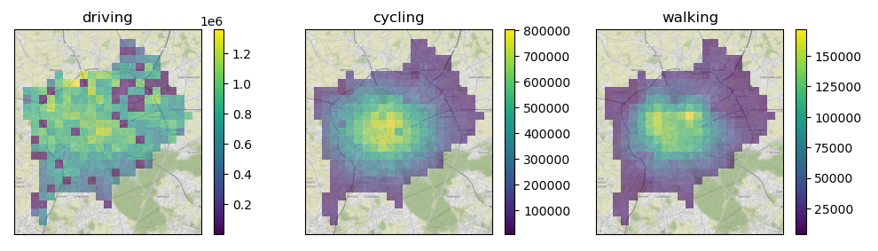

Database of Urban Transport Times
Qualitative comparison and analysis of transport inequality within and between cities.

Slide 2
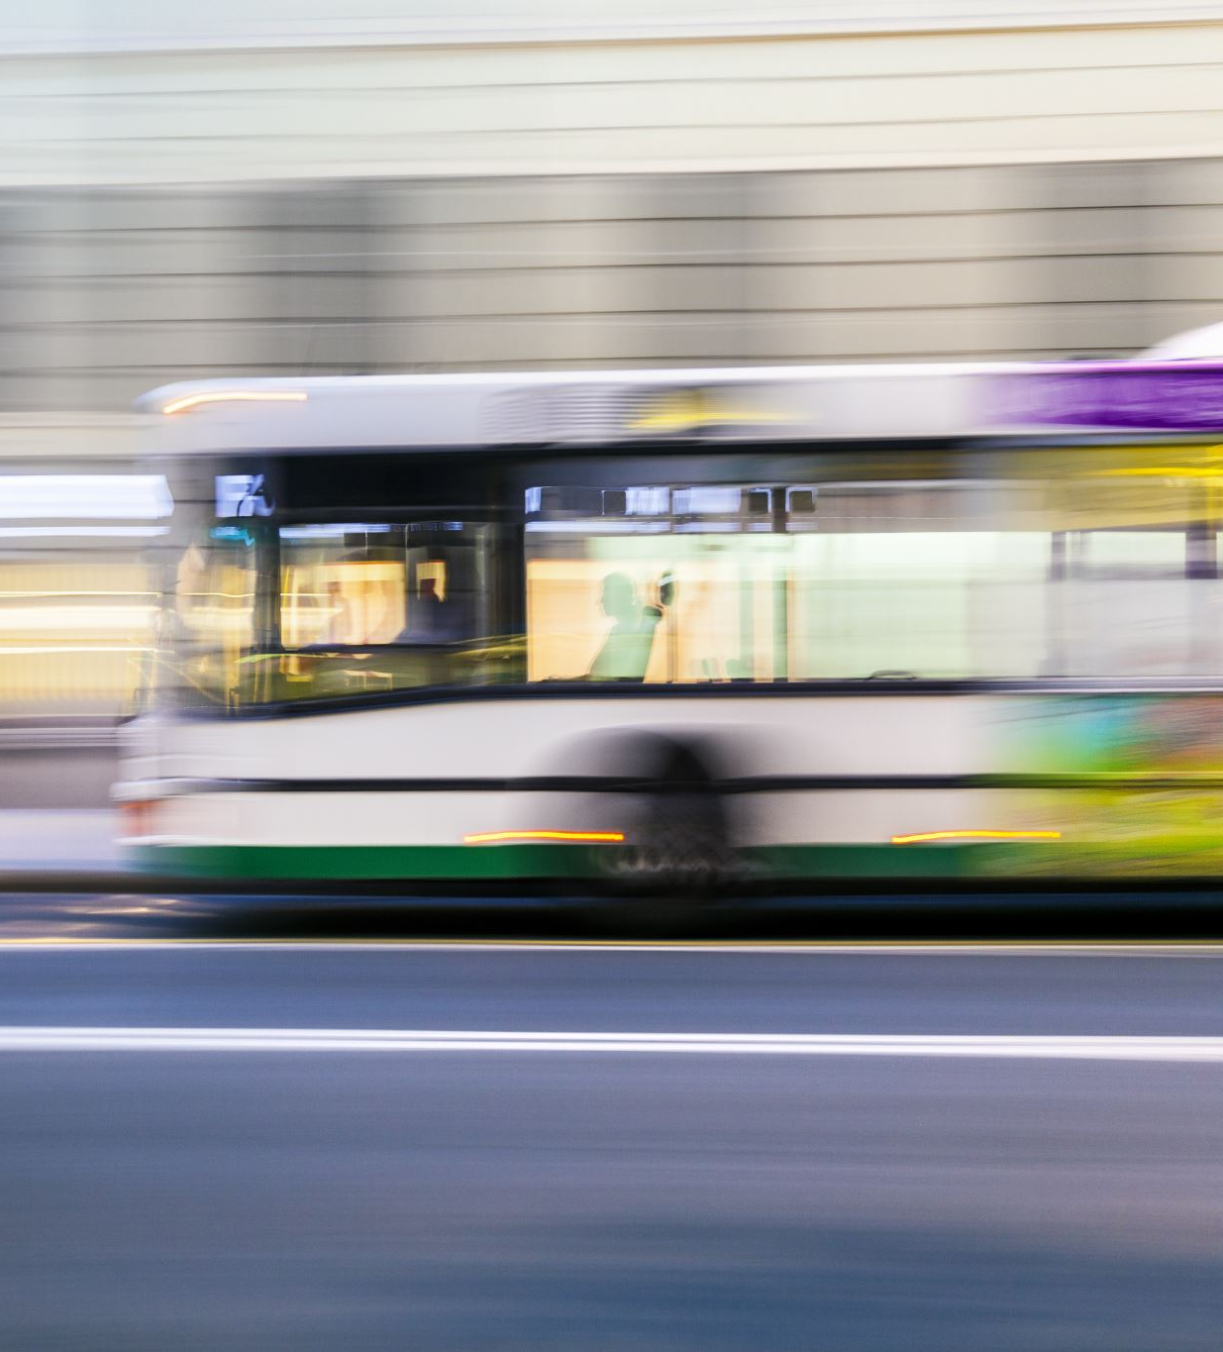
Accessibility Inequality
Mobility by car, bike, walking and transit.
Which areas of the city might be less mobile?
Using population density as a proxy variables for opportunities, more=better
Hypothesis: Areas in city center might be more attractive for cycling

Slide 3
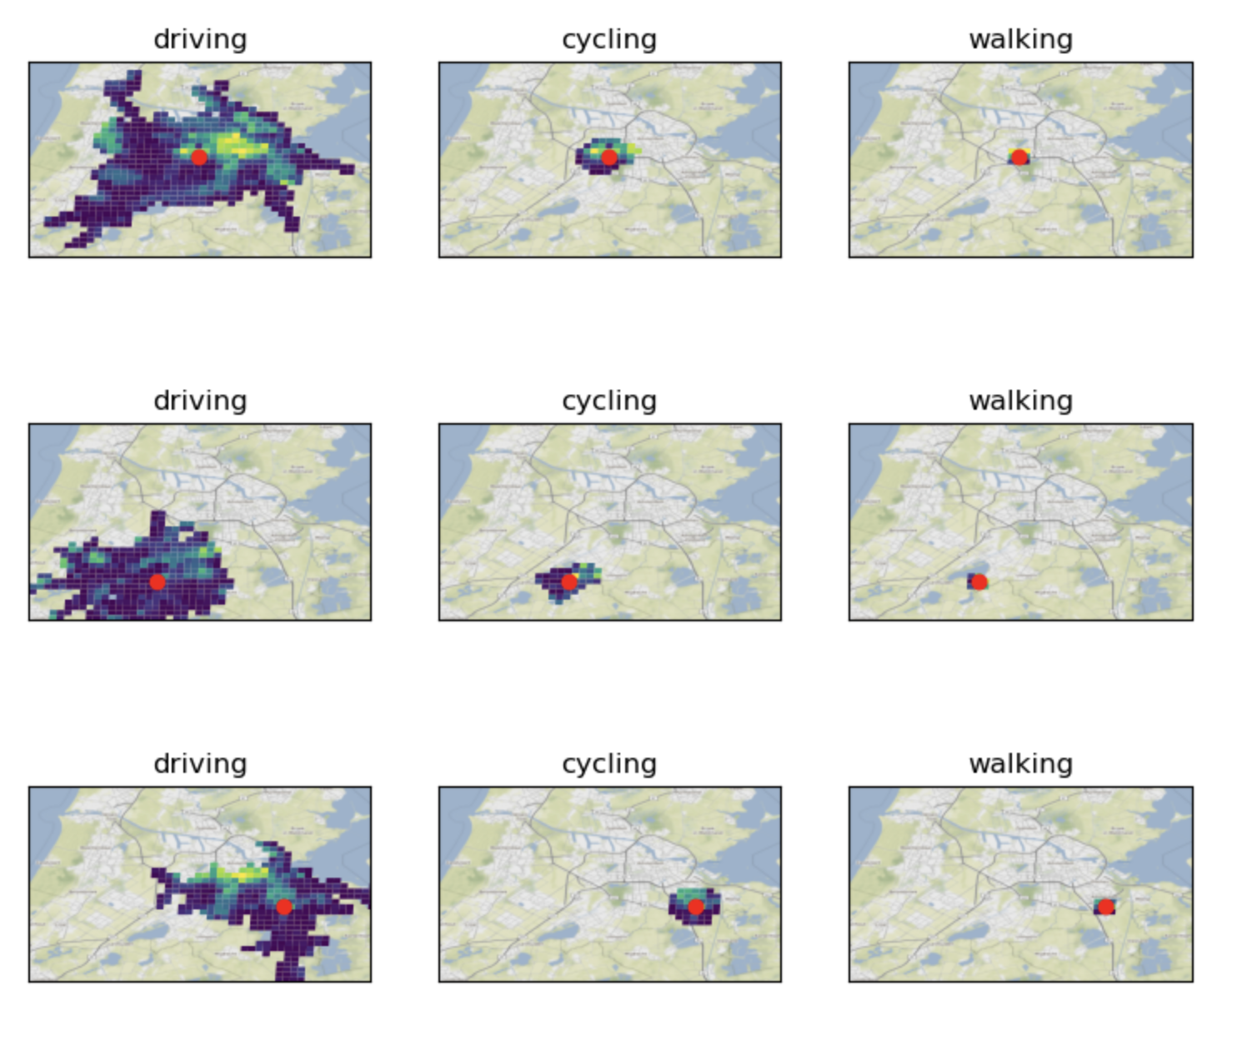
Lots of Isochrones as a measure
Meaning: Iso (equal) chrone (time)
Polygons of reachable areas by modality using max time.
Here right: isochrones and population density for 3 points

Slide 4
Cities Queried
Vienna
Graz
Brussels
Berlin
Hamburg
Copenhagen
Aarhus
Paris
Marseille
London
Birmingham
York
Luxembourg
Amsterdam
Utrecht + 5 more Dutch
Stockholm
Gothenburg
Helsinki
Oslo
Warsaw
Barcelona
Madrid
Lisbon
Bern
32 more scheduled..
Sources
GHS population and urban center grid
from Global Human Settlement Layer
GraphHopper:
driving, walking, cycling & transit
Bing Maps (academic):
driving (calibration for Graphhopper)
* Transit is not reliable enough from either source currently, working on GTFS-based GraphHopper, requires some small fixes.

Slide 5
For Each City:
Create raster with points
Query Bing for isochrones for car
Create OSM & TransitLand GTFS extracts for Graphhopper
Generate direction graph in GraphHopper docker
Fetch all records for all modes per city for 5-15-…-55 minutes
Calculate overlapping grids with isochrones
More than 150.000 isochrones collected (!)
Export as DataPackage

Slide 6
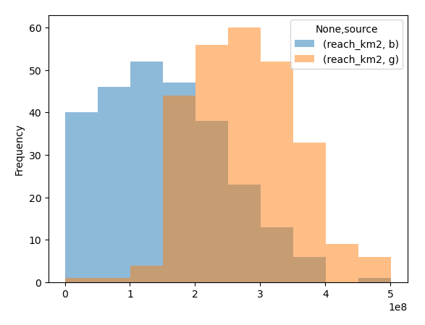
Graphhopper vs Here Maps (Brussels)
Graphhopper very optimistic with speeds, average speed should be brought down in settings. Requires full refetch!

Slide 7
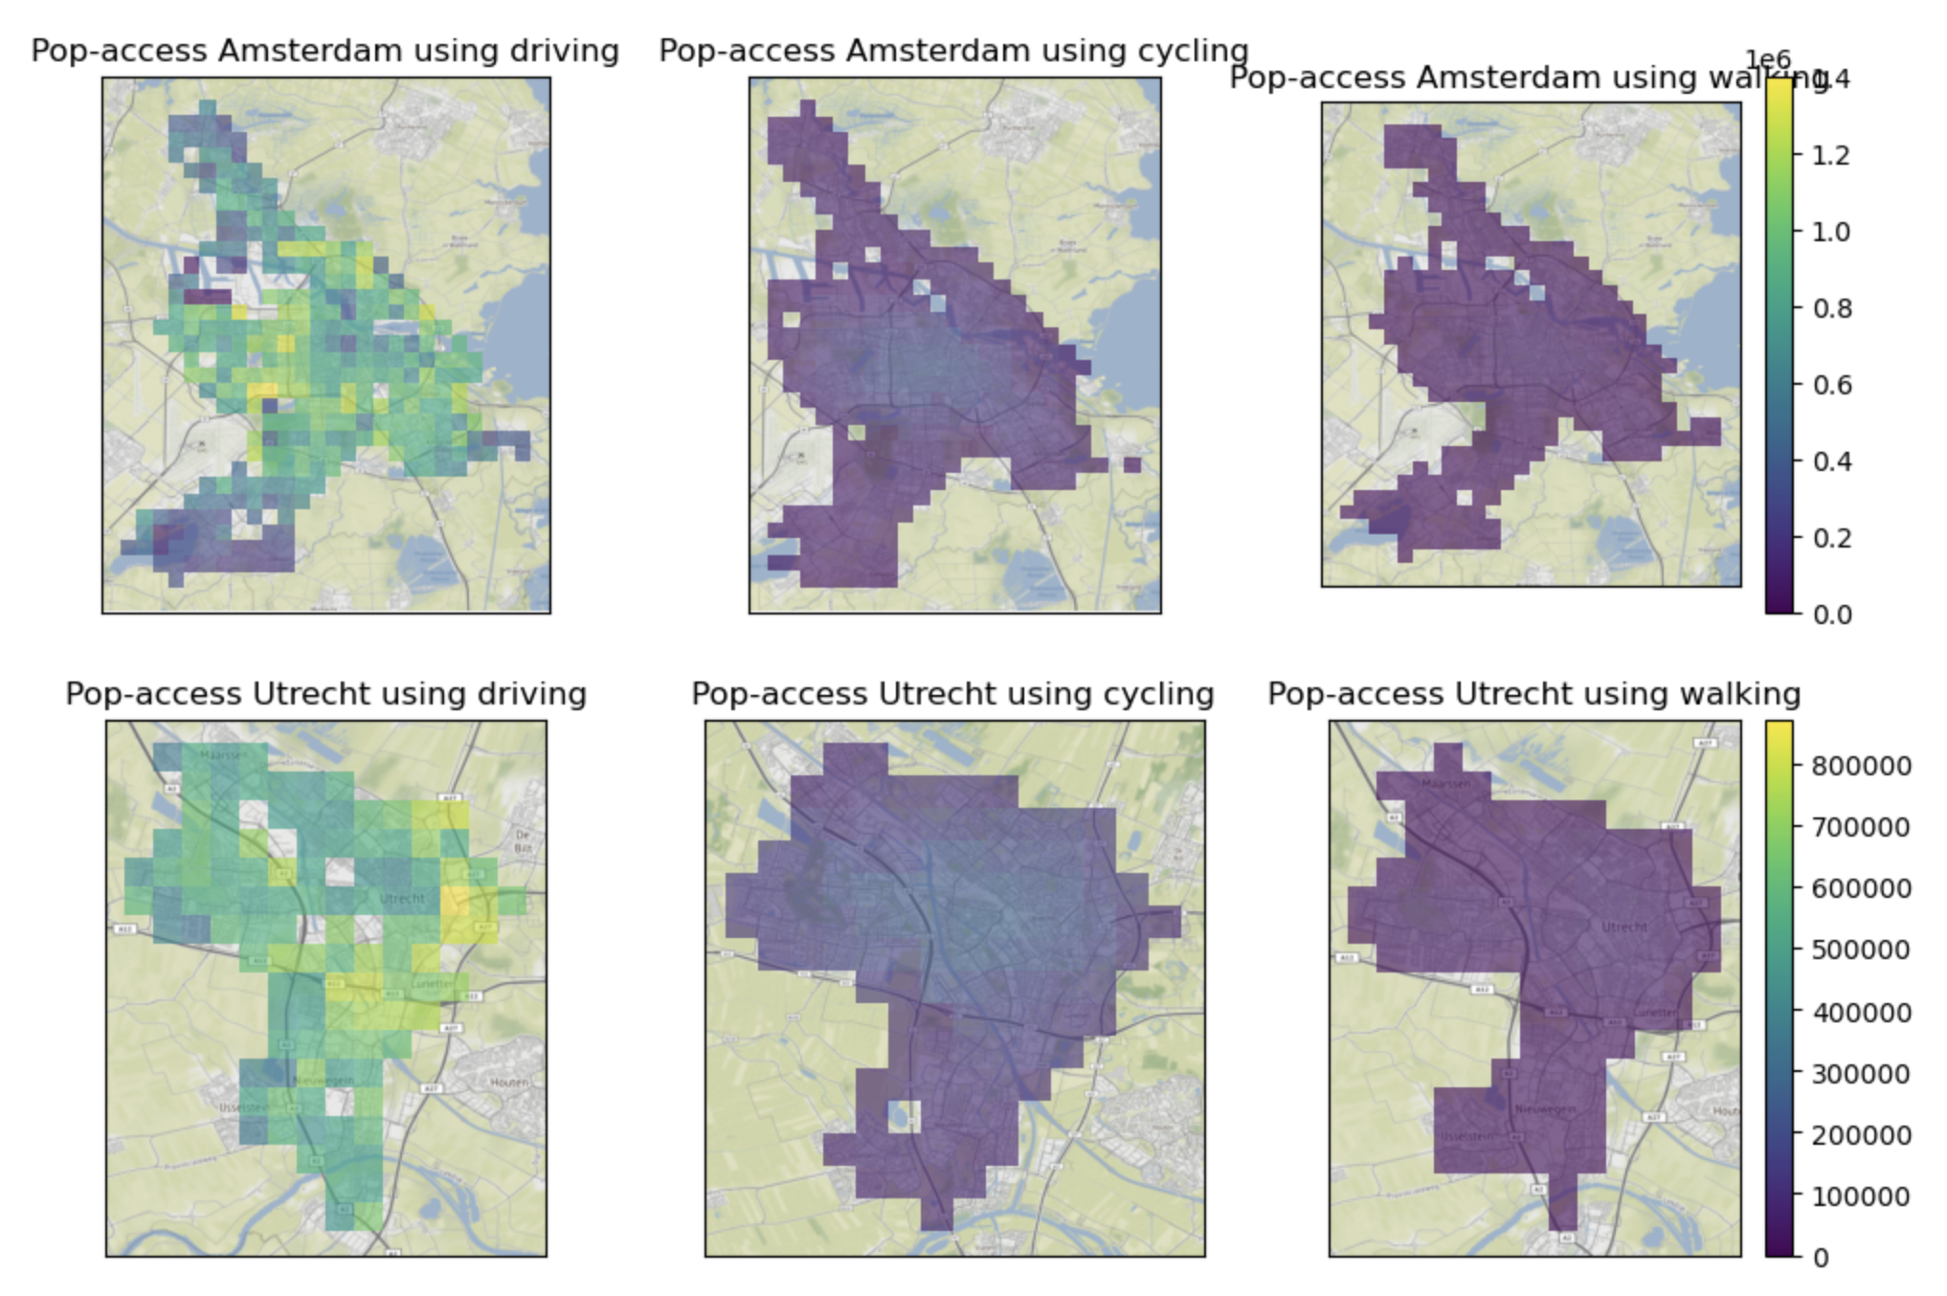
Population Access: Amsterdam & Utrecht

Slide 8
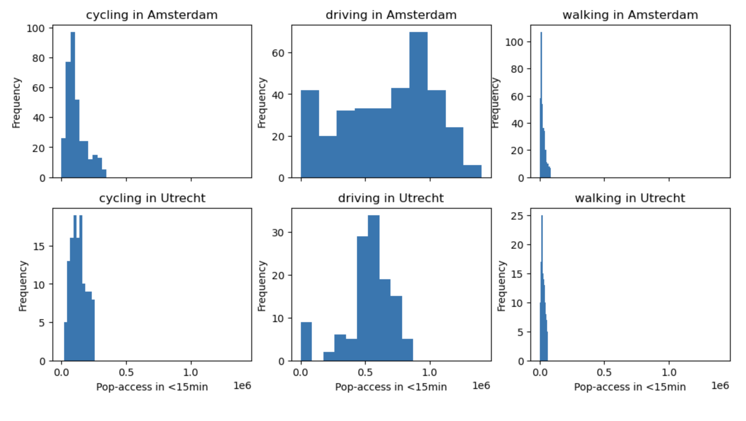
Example results: Amsterdam & Utrecht

Slide 9
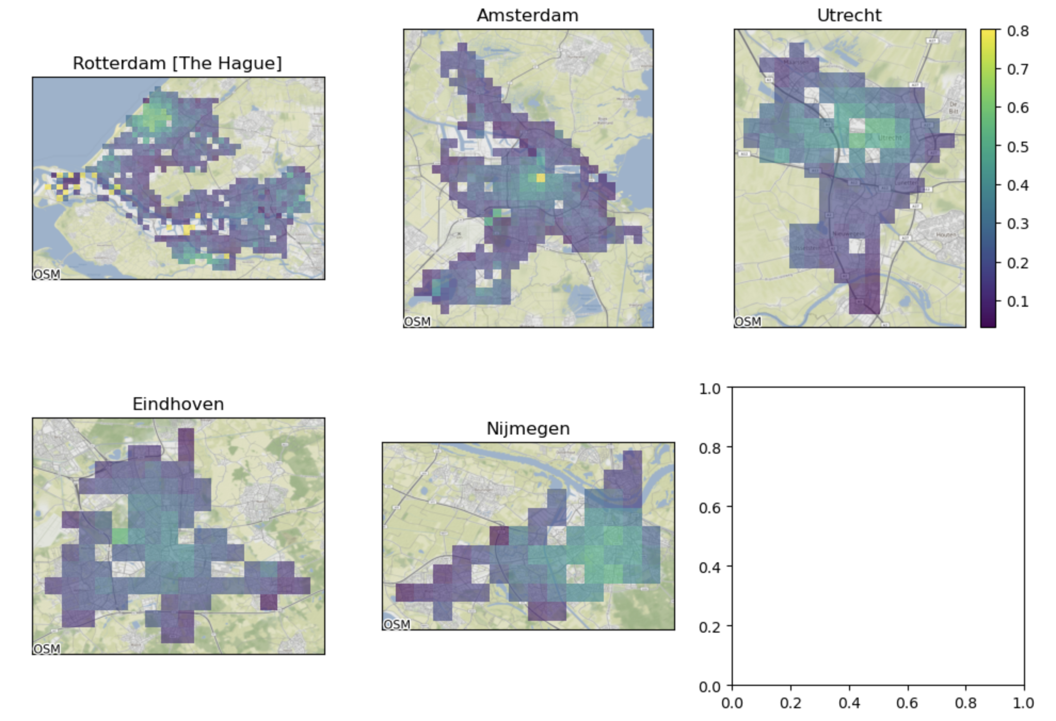
Example results in the Netherlands
A higher score means cycling reaches the same fraction of population as driving in does.
Excluding parking times, which averages more than 5 minutes.

Slide 10
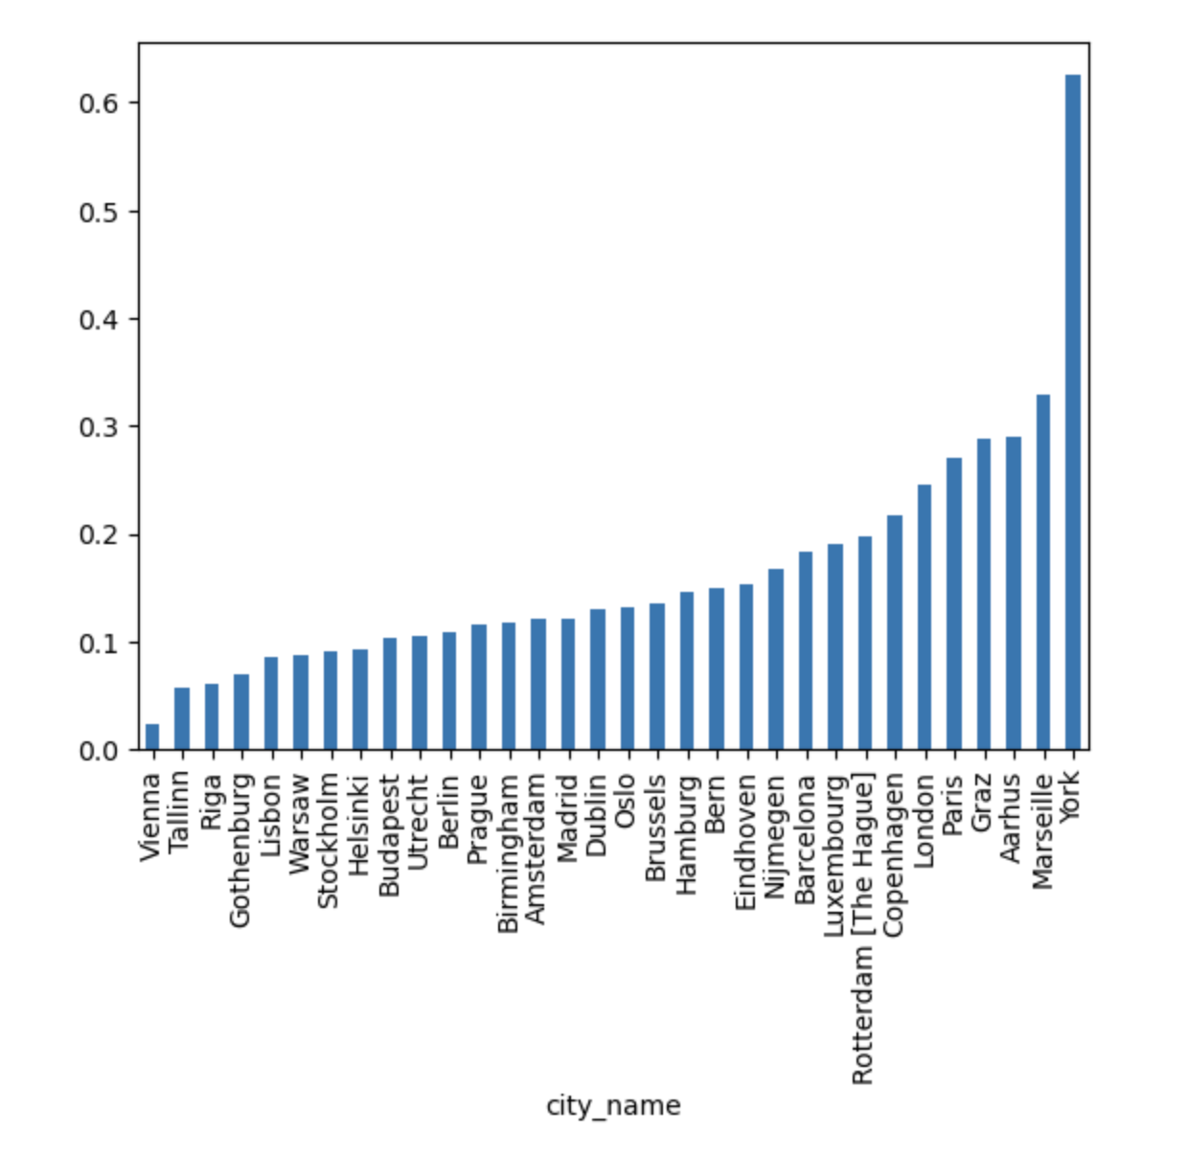
Example results in Europe
Reachable 0.5 by bike

Slide 11
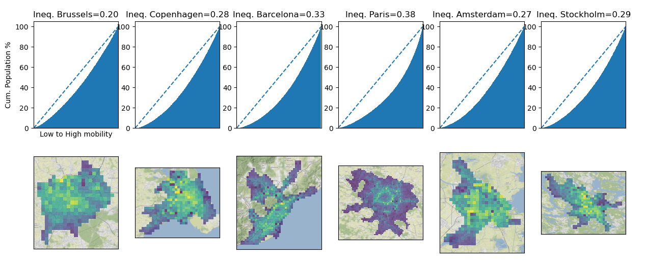
Gini Index
Preliminary Examples, lower=better (not corrected for population density
Ideas to compare cities or neighborhoods?

Slide 12
To-Do Generation
Analysis:
Average size of 15-minute isochrone
Average speed
Time to reach edge of isochrone
Can represent “Urban Form” factor as well, optimisation for bikes/cars
Generate characteristics from urban layout, more than just density.

Slide 13
Discussion
No correction of mobility vs population density. Good/bad?
What other methods/numbers can we derive from this?

